Slide 1






HASIL AKHIR UML
Nama-nama Kelompok:
Carlos Immanuel Tampubolon 222310064
Sandry Chnadra Putra 222310065
Aron Alexanda 222310049
Yefta Julio Rusli 222310032

Slide 2
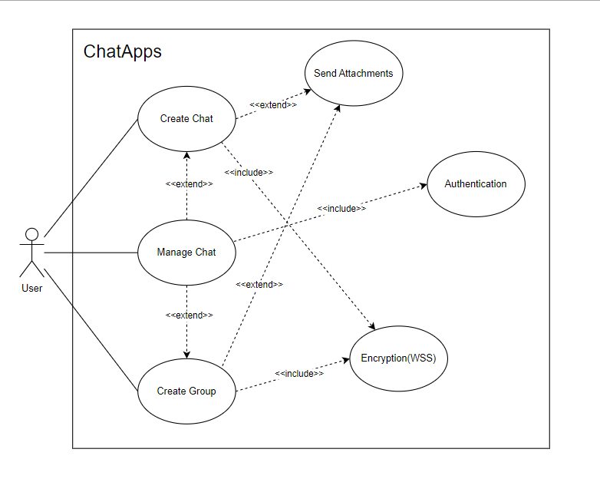
USE CASE

Slide 3
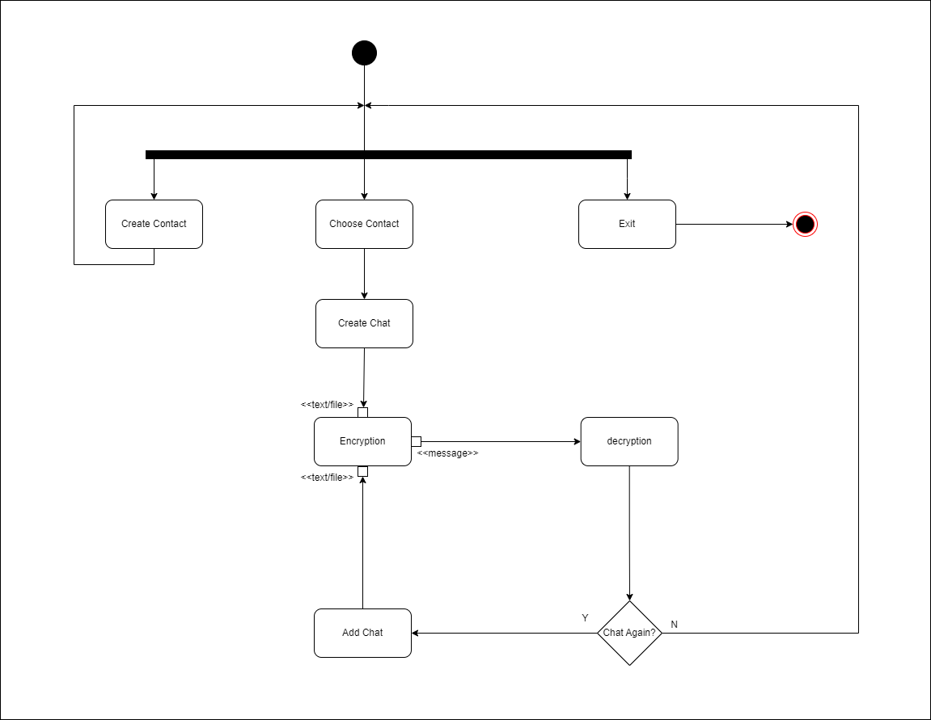
ACTIVITY DIAGRAM

Slide 4
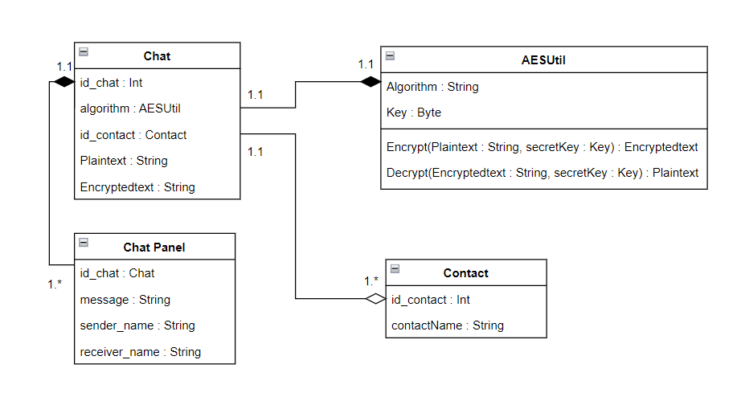
CLASS DIAGRAM

Slide 5




Thank You

